Slide 1
Forces: Friction
Mrs. Allen
8th Grade Physical Science

Slide 2
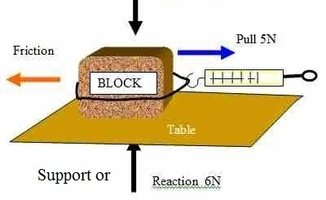
Friction: A Force That Opposes Motion
Friction = A force that opposes motion between two surfaces that are in contact
Friction happens because the surface of any object is rough (even those that feel smooth)
The microscopic “mountains” of one surface stick to the “valleys” of the other surface

Slide 3
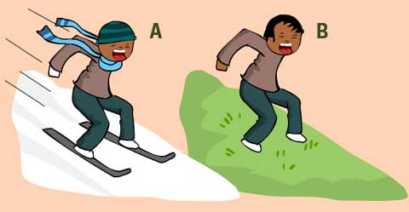
Friction: A Force That Opposes Motion
Factors that affect the amount of friction include:
the force pushing the surfaces together
the roughness of the surfaces

Slide 4
The Effect of Force on Friction
If the force pushing the surfaces together increases, the “mountains and valleys” come into closer contact, which increases the friction

Slide 5
The Effect of Force on Friction
Objects that weigh more have a greater downward force than objects that weigh less, which also increases friction (harder “push” required to move the object)

Slide 6
The Effect of Force on Friction
Changing how much the surfaces come into contact does not change the amount of friction

Slide 7
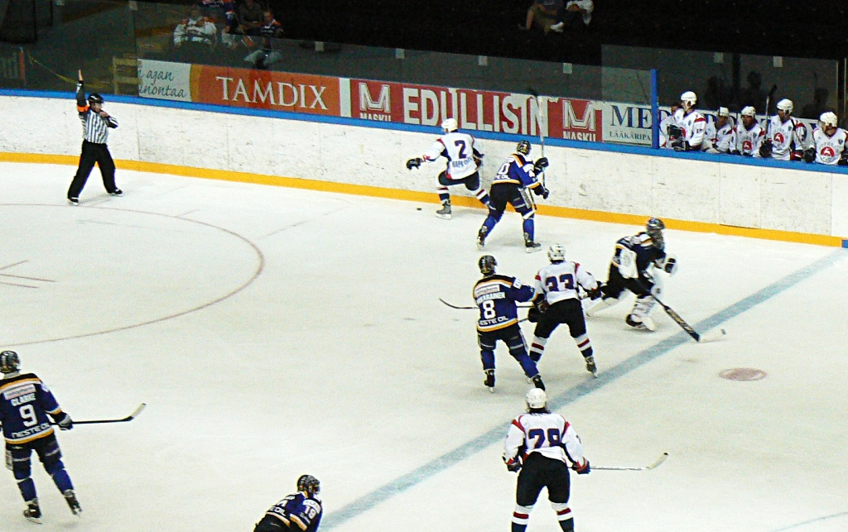
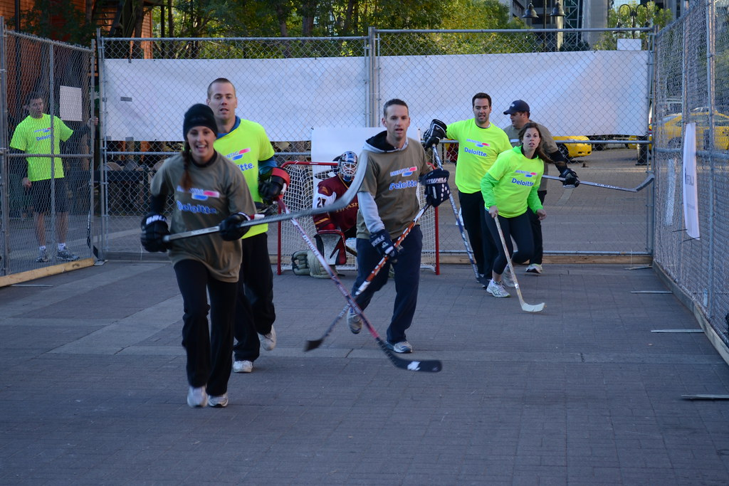
The Effect of Rougher Surfaces on Friction
Rough surfaces have more “mountains and valleys” than smooth surfaces, therefore more friction
Ex. Trying to play hockey on cement vs. trying to play hockey on ice – the puck will slide easier on the ice because it is a smoother surface and has less friction

Slide 8
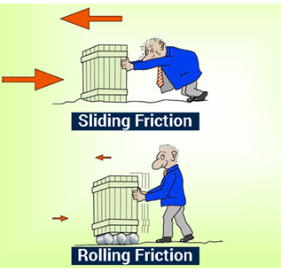
Kinetic Friction
Kinetic Friction – friction between moving surfaces;
Depends on how the surfaces move: sliding or rolling
Usually the force of sliding kinetic friction is greater than the force of rolling kinetic friction; therefore, it is usually easier to move an object on wheels

Slide 9
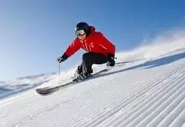
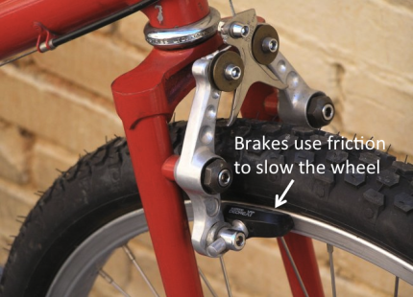
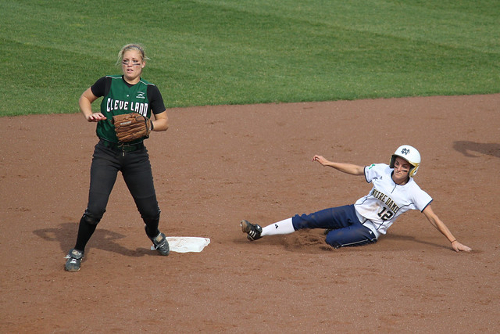
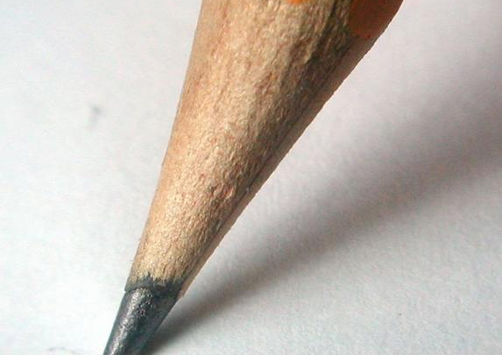
Sliding Friction
Ex. brakes on a bicycle, writing with a pencil, sliding into a base, skiing

Slide 10
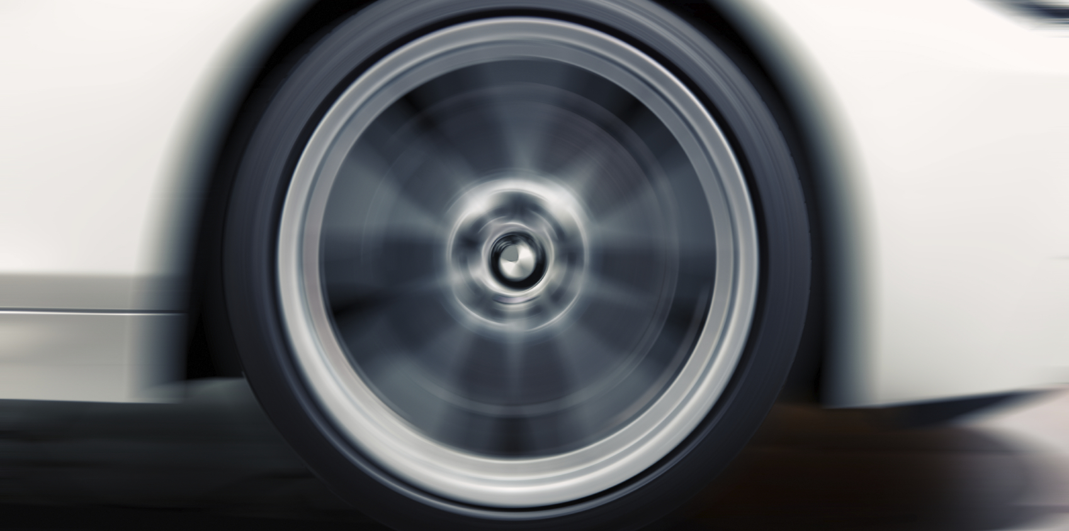
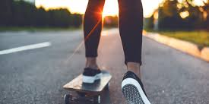
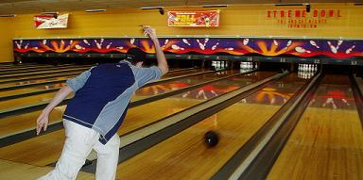
Rolling Friction
Ex. anything that has wheels (bicycle, car, train, airplane, etc.)

Slide 11
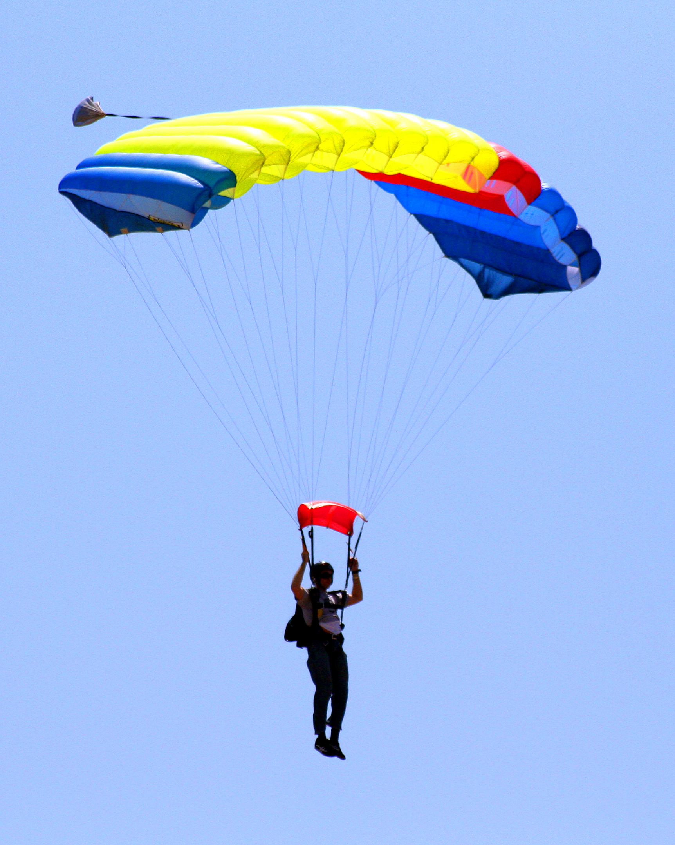
Fluid Friction
Friction that acts on objects that are moving through liquids and gases
Ex. If you've ever tried to push your open hand through the water in a tub or pool; you can feel the resistance of the water against your hand
Ex. The skydiver is falling toward Earth with a parachute. Resistance of the air against the parachute slows his descent.
The faster or larger a moving object is, the greater the fluid friction resisting its motion
That's why there is greater air resistance against the parachute than the skydiver's body.

Slide 12
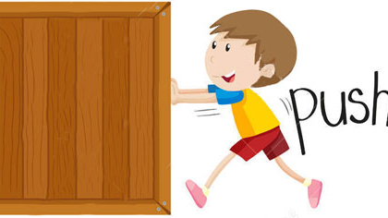
Static Friction
Static Friction – when a force is applied to an object, but does not cause the object to move
The force of static friction balances the force applied, so the object does not move
Can be overcome by applying a large enough force
Disappears as soon as the object begins to move & kinetic friction takes over

Slide 13
Static Friction to Kinetic Friction

Slide 14
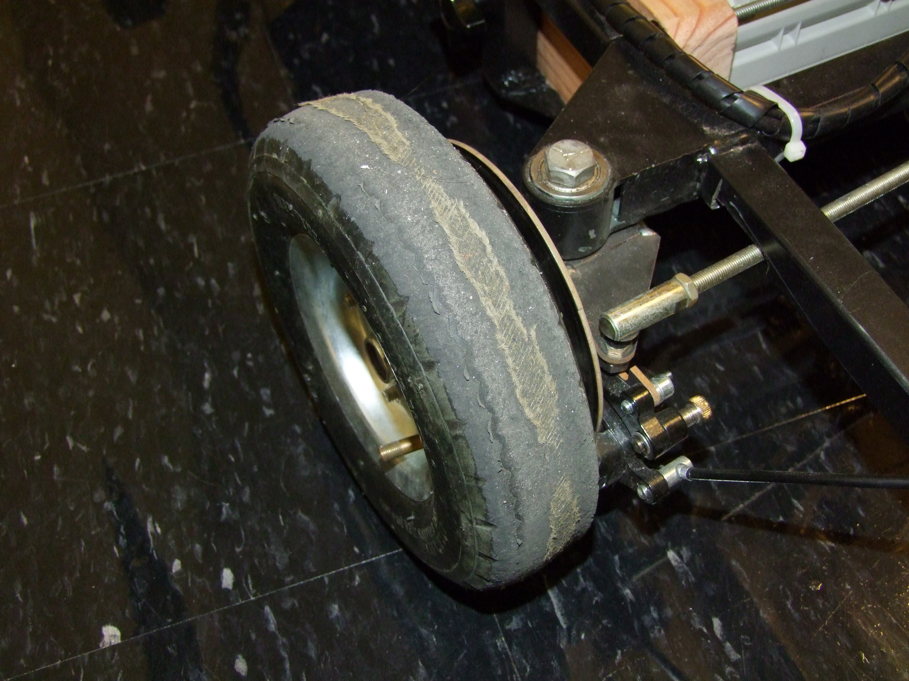
Uses of Friction
Helpful
Harmful
Prevents slipping and sliding when walking, riding a bike, and driving a car
Helps objects to slow down or stop moving; helps control motion
Allows objects to move
Wears away at surfaces
Ex. Tires on a car need to be replaced periodically because friction between the road and tire wears down the tires
When surfaces rub together too much because of friction and they overheat
Ex. Engine parts

Slide 15
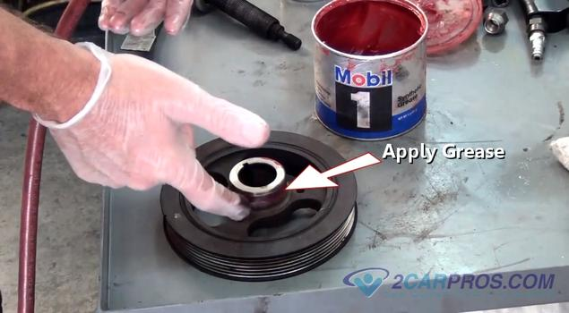
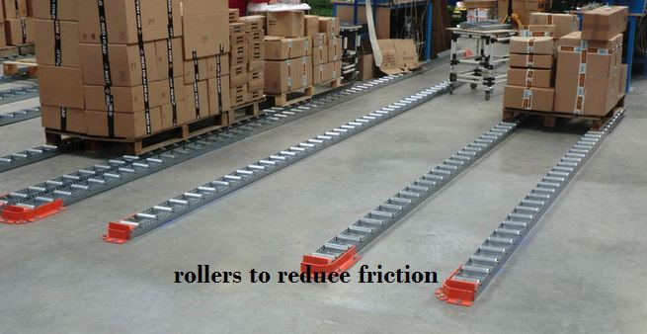
Reducing Friction
Applying lubricants (oil, wax, grease)
Polishing a surface (making it smoother)
Reduce the contact between the surfaces (ex. by adding wheels)
Reduce the forces acting on the surfaces (ex. less weight)

