Slide 1
What is Gravity?

Slide 2
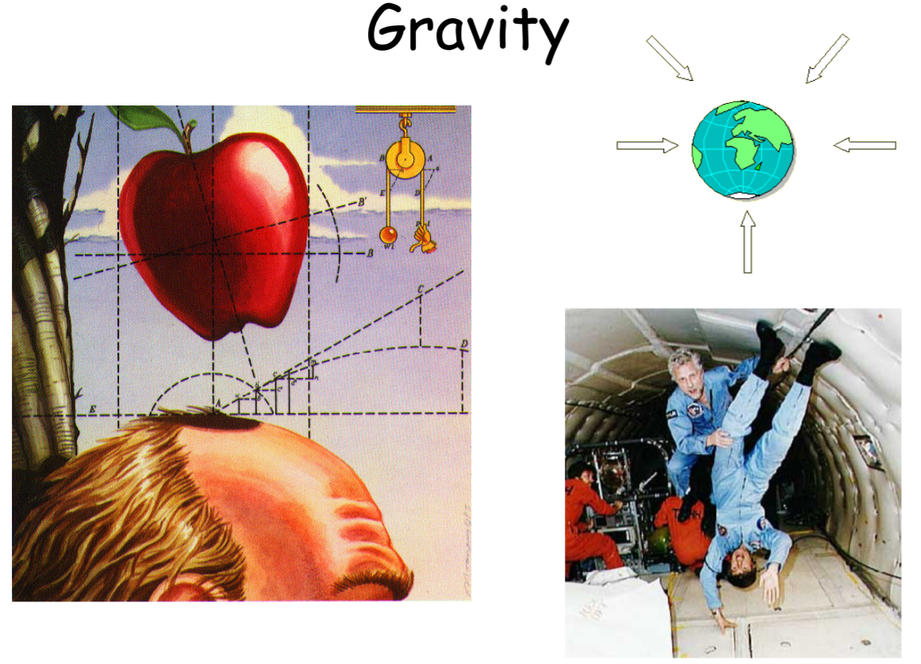

Slide 3
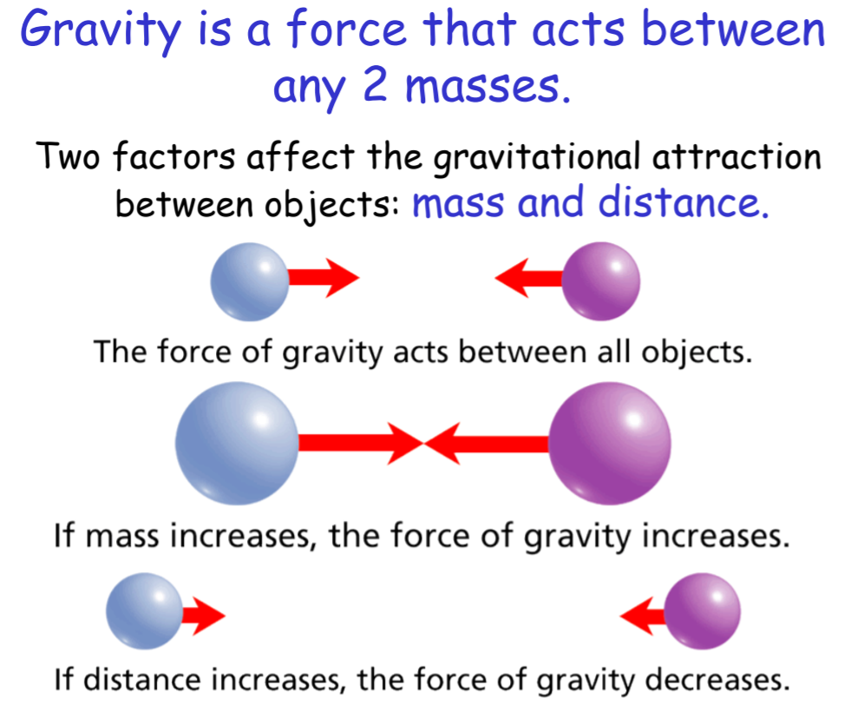

Slide 6
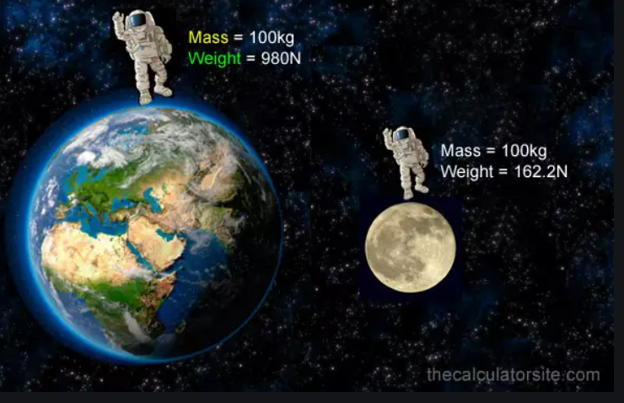
Would you be heavier or lighter on the moon?
The moon’s mass is roughly 1/6 of the Earth
So… you would weigh 1/6 of your weight on Earth!

Slide 13
Will a dropped hammer and a feather fall at the same rate on the moon?
Check out this YouTube video
https://www.youtube.com/watch?v=l7tEA8Vtc0o

Slide 15
Air Resistance

Slide 20
The End

