Slide 1
Motion

Slide 2
When describing something that is moving, you are comparing it with something that is assumed to be stationary (not moving).
The frame of reference is the background or object that is used for comparison.
Ex: You are on a train that just left the platform.
The people standing on the platform see you moving away. (earth is the frame of reference)
The person sitting next to you does not see you moving. (train is the frame of reference)

Slide 3
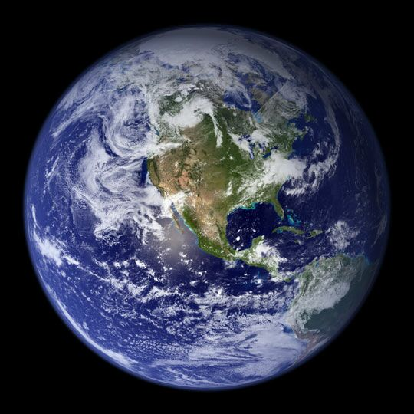
Frame of reference depends on the type of movement and position from which you are observing.
An actor may be standing still and the background is moving, but to us we think the actor is going somewhere.
We assume the background
is stationary.
Earth is the most commonly
used frame of reference.

Slide 4
Motion
Motion is a change in position in a certain amount of time.
When you say that something has moved, you are describing motion.
In describing motion, you are comparing it with some frame of reference.

Slide 5
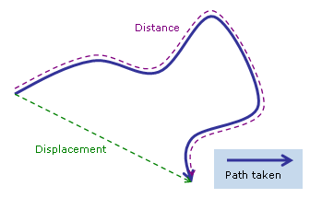
Distance vs Displacement
Distance is a scalar quantity which refers to “the amount of ground an object has covered" during its motion.
Displacement is a vector quantity which refers to the overall change in position of the object from start to finish.

Slide 6
Speed
In a race, the runners had to move or change positions to get to the finish line in a certain amount of time.
To describe motion you need to know:
distance traveled (meters – m)
how long it took to go that distance (seconds – s)

Slide 7
Speed
Speed is the rate at which an object moves.
The faster a runner’s rate of motion, the faster the runner’s speed.
Speed = distance/time
Units = m/s

Slide 8
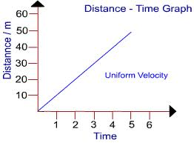
Constant Speed
Objects in motion that their speed does not change is moving at a constant speed.
Total distance divided by total time give speed at any point in time.
Graph is a straight
line for constant speed.

Slide 9
Instantaneous Speed
The speed an object is travelling at a specific moment in time (ex. You look at the speedometer in your car and you are going 62mph…that is your instantaneous speed at that second!)

Slide 10
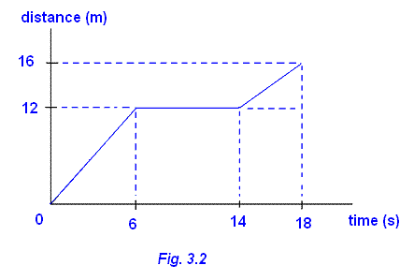
Average Speed
Not all objects move at constant speeds.
The average speed also uses the formula speed = total distance/ total time
Going to Columbus, you
change speeds during the
drive many times. So over
all you travel at an average
speed.

Slide 11
Velocity
Velocity is speed in a given direction. It is also determined by using the distance from the starting position to the ending position, rather than the distance of the path taken.
A runner moves eastward at 10m/s.
speed is 10m/s
velocity is 10m/s east
Velocity is very important for airplane pilots, weather forecasters and anyone driving from one place to another.

